Slide 1
A Few Object-Oriented Design Principles:
Foundations of Design Patterns

Slide 2
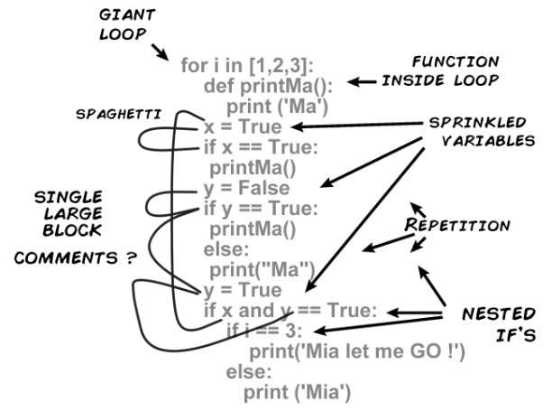
Symptoms of Rotten Code
The system is rigid:
  Hard to change anything because when making one change, need to change everything.
The system is fragile:
  Changes cause the system to break at the strangest of places.
The system is immobile:
  Not reusable.
The system is viscous:
  The system is opaque —hard to understand.
  The system is needlessly complex.
  The system contains needless repetition.
  Changing a functionality in even minor ways is hard.

Slide 3
Main Culprit: Dependencies in Design
Dependencies can arise among classes, packages, and subsystems:
  Due to a large number of reasons…
Unless dependencies are kept to a minimum:
  Design and code become unmaintainable
  Even small modifications break the system
  Scope of reuse diminishes
  Too many bugs and test/debug costs rise

Slide 4
Common Causes of Dependency
Tight coupling among classes
Improper use of inheritance
  Ex: Subclassing a concrete class
Creating an object by explicitly specifying a class.
Dependence on specific operations
Dependence on hardware and software platforms

Slide 5
What is the penalty for poor Dependency Structure?
Software will typically exhibit several negative traits:
It is rigid
It is fragile
It is not reusable
It has high viscosity

Slide 6
It is Rigid
It is hard to alter any behavior:
  Even a small change affects too many other parts of the system…
  Impact of a change cannot be predicted
    Time and cost for a change cannot be quantified…
Managers become reluctant to authorize any change:
  Bug reports and maintenance requests are kept pending as long as possible…

Slide 7
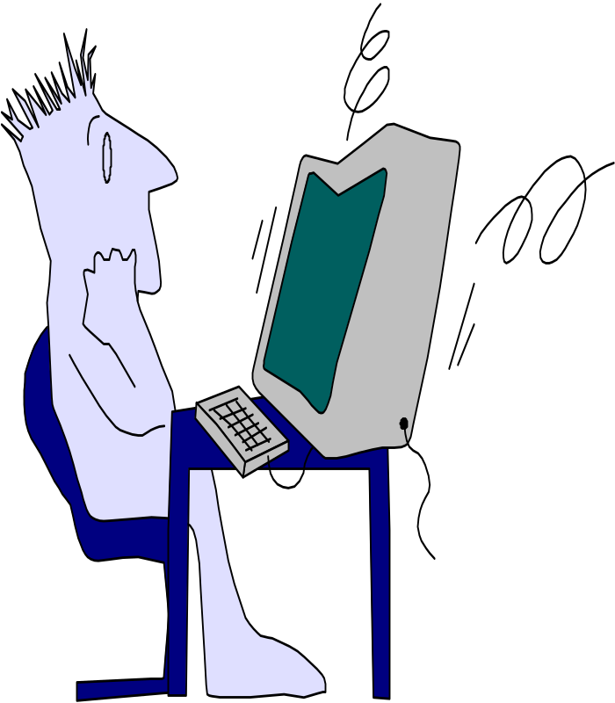


It is Fragile
Software changes seem to exhibit non-local effects
A single change requires a cascade of subsequent changes…
New errors appear in areas that seem unconnected to the changed areas…
The development team loses credibility…

Slide 8
It is not reusable
Parts are too entangled
Desirable parts of the design depend on several undesirable parts…
The effort and risk of
extracting desirable parts:
  Exceed the cost of redeveloping
  from scratch.
Notes:
.

Slide 9
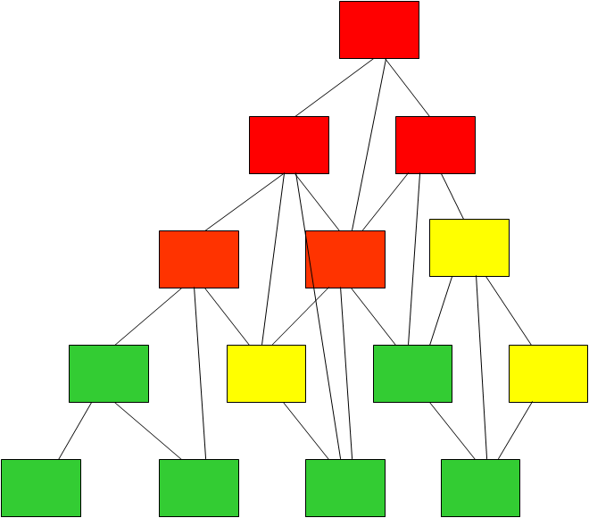
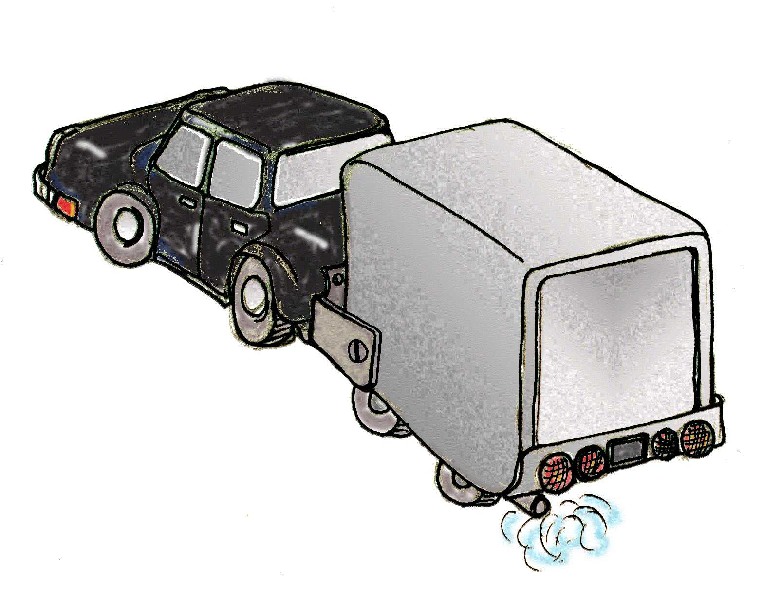
The case of Welded Trailer…
Only van is needed…
---But would have to take the trailer along…

Slide 10
High Viscosity
Difficult to understand the system:
  Hard to correctly make even small changes without breaking the design → make hacks instead
Consequences:
  Slow and inefficient development
  Incentive to apply ad hoc fixes even at the risk of breaking the design
  Design changes are very difficult

Slide 11
Designing for Change
Maintenance is inevitable --- So if a design is hard to change:
  It incurs the risk of major cost overhead and redesign in the future.
Design patterns --- an attempt to make it easy to change a software:
  Each design pattern lets different aspects of a system’s structure to vary independently of other aspects.

Slide 12
SOLID Principles to Avoid Poor Design
Acronym of 5 acronyms:
  SRP: Single Responsibility Principle
  OCP: Open-Closed Principle
  LSP: Liskov Substitution Principle
  ISP: Interface Segregation Principle
  DIP: Dependency Inversion Principle

Slide 13
The Open/Closed Principle (OCP)
based on an article of that title by Robert Martin

Slide 14
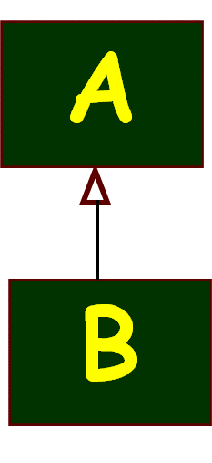

Statement of OCP Principle
Classes should be open for extension, but closed for modification.
  Open:
  A class is open if it can be extended:
    Add data members and operations through inheritance.
  Closed:
  A class is closed if it is available for use by other components but it cannot be changed:
    It can be put under a configuration control tool, allowing read only access.

Slide 15
Origin and Motivation
The open/closed principle was first discussed as a fundamental object oriented principle:
  by Bertrand Meyer in: “Object Oriented Software Construction”, Prentice-Hall, 1988.
In large and complex systems, changes are frequent. Possible reasons:
  Changing requirements
  Latent errors
  Performance issues

Slide 16
Motivation
A small change to a class should not cause a cascade of changes to other classes.
Open/closed principle statement:
  Once a class has been successfully tested --- it should never be changed, only extended to meet any changes required.

Slide 17
Indication of OCP Violation
A simple change to a class:
  Requires changes to be made to several other classes…
  Seemingly unrelated classes get affected…
An example:
  A programmer extended class A in minor ways but was surprised to see the methods of base class break down.

Slide 18
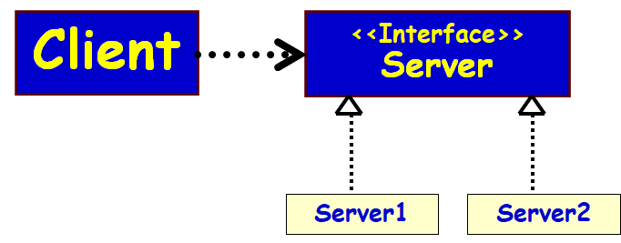
Solution
If you are not changing working code:
  You are unlikely to break it.
Define an abstract or interface class:
  Extend the interface/abstract class whenever any new feature is required.
  The client class selects the appropriate object through dynamic binding.
Program to an Interface.

Slide 19
Key Design Ideas of OCP
Open:
  Can add functionality or data by extending it.
Closed:
  Can not modify it.
  Its protocol available to other classes for usage, itself does not change.
  That is, it has a stable interface
  Implemented with interface/abstract classes
  Sometimes achieved using composition

Slide 20
The Role of Interface/Abstract Class
It is very difficult to build a class that would never be required to change.
Two unavoidable reasons for changes to a class:
  Latent errors force change. We can’t fix incorrect operation by extension. The component itself must be fixed.
  Performance problems force change. Met usually by changing an algorithm or some data structure.
Changes due to other reasons:
  Can be achieved through extension.

Slide 21
How to Prevent Clients to Change Even When a Server Class Changes?
When a server class changes:
  Clients of the class should not be required to change.
  How to achieve?
Principle: Let a server class implement some agreed Interface.

Slide 22
Programming to an Interface
When we program to an Interface:
  A change to a server class which implements the Interface will not even require recompilation of clients.
What we can’t do is change the Interface definition.
  Any change here may force changes on its clients.

Slide 23
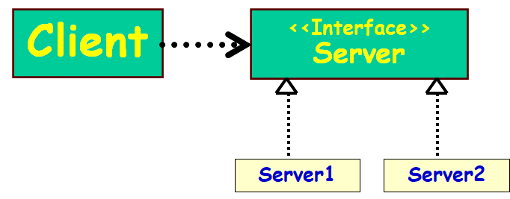
Using Interface for Decoupling…
How to avoid changing and recompiling clients each time server changes?
Instead of making supplier as a concrete class, make it an interface.
  Concrete providers should not be subclasses of a concrete server,
  but instead be realizations of interfaces…
Client
Server
How to do this?

Slide 24
OCP: Client-Server Example
Client
Server
OCP violation:
  When server changes would require changes to the client.
Client
<<Interface>>
Server
OCP
Compliant
Server1
Server2

Slide 25
Use Interfaces/Abstract Classes
Use of interfaces/Abstract Classes is a key idea in the Open/Closed Principle.
  Interfaces are implemented, but are themselves closed to modification.
  Since Interfaces have no implementation, they have no latent errors to fix and no performance issues.

Slide 26
OCP Through Use of Interfaces
Component 2
Component 1
Component 3
Component 4
Component 5

Slide 27
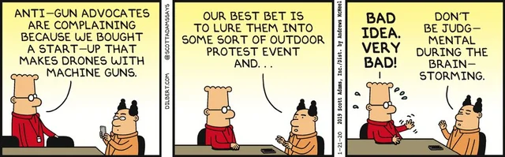

Slide 28
OCP Using Abstract Classes
Client
<<abstract>>
Server
<<Uses>>
Server1
Server2
New types of servers can be added, by extending (or specializing) the Abstract Server class.

Slide 29
Example 1
An educational Institute has various types of employees:
  Faculty
  Technical staff
  Secretary
The employee details are maintained in an employee roster
Construct the domain model

Slide 30
Example 1: Naïve Solution
Emp
Roster
*
OCP Violation
Employee
+int EmpType
Faculty
+getOffice()
Staff
+getDept()
Secretary
+getTypeSpeed()
Engineer
+getEngTYpe()
void printEmpRoster(Employee[] emps) {
for (int i; i<emps.size(); i++) {
if (emps[i].empType == FACULTY)
printfFaculty((Faculty)emps[i]);
else if (emps[i].empType ==STAFF)
printStaff((Staff)emps[i]);
else if (emps[i].empType == SECRETARY)
printSecretary((Secretary)emps[i]);
}
}
What if we need to add Engineer??

Slide 31
OCP Compliant Solution
Emp
Roster
*
<<Interface>>
Employee
+printInfo()
Faculty
+printInfo()
Staff
+printInfo()
Secretary
+printInfo
Engineer
+printInfo()
void printEmpRoster(Employee[] emps) {
for (int i; i<emps.size(); i++) {
emps[i].printInfo();
}
}
When Engineer is added, printEmpRoster() does not even need to recompile. PrintEmpRoster() is open to extension, closed for modification.

Slide 32
Role of Interfaces/Abstract classes
Dependencies vanish when Interfaces or Abstract classes are used :
  Effectively decouples clients and servers…
Use of Interfaces/ abstract classes is fundamental to design pattern solutions.
Client
<<abstract>>
Server
<<Uses>>
Server1
Server2

Slide 33
Java code
Client
<<abstract>>
Server
<<Uses>>
Server1
Server2
public abstract class AbstractServer{
public abstract void operation();
}
public class ConcreteServer extends AbstractServer {
private int attribute;
public void operation() {
// implementation of operation
}
}

Slide 34
Example 2: Naïve
Solution
Shape
shapeType : int
Circle
Square
origin : Point
radius : float
length : float
center : Point
width : float
drawCircle(circle: CircleData)
drawSquare(square : SquareData)
ShapeEditor
drawShape(shape : ShapeData)

Slide 35
class Shape {
int shapeType;
}
class Rectangle extends Shape {
Rectangle() {
super.shapeType=1;
}
}
class Circle extends Shape {
Circle() {
super.shapeType=2;
}
}
// Inferior Solution
class ShapeEditor {
public void drawShape(Shape s) {
if (s.shapeType==1)
s.drawRectangle();
else if (s.shapeType==2)
s.drawCircle();
}
}

Slide 36
Example 2 OCP-Compliant Solution
<<Interface>>
ShapeInterface
SmartShapeEditor
SmartShapeEditor is closed against changes from adding new shapes
It is open for extension, e.g. drawing new shapes
Just add new shapes and relink
drawShape(shape: ShapeInterface)
draw()
move()
public void
drawShape(ShapeInterface shape){
shape.draw();
}
Circle
Square
draw()
move()
draw()
move()

Slide 37
// Open-Close Principle – Compliant Solution
abstract class Shape{
void draw();
}
class Rectangle extends Shape{
public void draw() {
// draw the rectangle
}
}
class ShapeEditor{
public void drawShape(Shape s) {
s.draw();
}
}

Slide 38
Achieving OCP
OCP usually achieved using:
  Abstract/interface classes
  Composition (plug-in)
Should you prefer Abstract class or Interface?
  Ans: Depends. If some code needs to be shared, abstract class should be used. Otherwise, Interface classes.

Slide 39
How to Handle Interface Change Requirement?
Suppose you need to add an additional method to a stable interface due to new requirements.
How can it be done without modifying the Abstract Server/Interface class?
Client
<<abstract>>
Server
<<Uses>>
Concrete
Server 1
Concrete
Server 2

Slide 40
Inferior design
How to add a new method to the interface due to a new requirement?
Client
<<abstract>>
Server
<<Uses>>
Modify the abstract server!
  Clients have to be modified and recompiled
The new method will have to be implemented in all existing concrete supplier classes:
  Or a default implementation can be provided by the abstract supplier…
Concrete
Server 1
Concrete
Server 2

Slide 41
Better Design: Extend the Interface
Client
<<Interface>>
Server
Server1
NewClient
<<Interface>>
ServerExt
Server3
Server4

Slide 42
Summary
The Open/Closed Principle states:
  Well designed and tested code can be extended and not modified.
  New features are added by adding new code rather than changing already working code.
Software to be reusable, maintainable, and robust:
  Must be extensible without requiring changing working code.
  Interface classes are the key

Slide 43
OCP Summary cont..
OCP is a cornerstone to good OOD.
Several patterns directly support implementing OCP:
  E.g. Factory, Strategy, and template patterns
Several other patterns indirectly enforce OCP

